Slide 1
Capstone – Recommending Relocation Neighborhood
By Ilya Turian

Slide 2
Introduction
An Imaginary Software Company has offices in 3 cities:
New-York
London
Toronto
Due to business requirements, employees are often required to relocate between those cities.

Slide 3
Introduction
The company has a great interest in keeping it’s employees happy and therefore the HR department provides assistance in the relocation process.
The most common questions asked are related to finding housing in the new town. And specifically :
“In which neighborhood in the new area should I look for apartment?”

Slide 4
“In which neighborhood in the new city should I look for apartment?”
To answer the above question we will resort to Data Science and machine learning.
We are basing our work on the following assumptions:
The employee would like to live in an area similar to the area he currently live in.
We can get a good characteristic of an area by scrapping Foursquare data and finding the most common venues in that area. This data should represent the general atmosphere and type of the neighborhood.

Slide 5
“In which neighborhood in the new city should I look for apartment?”
The general plan is to gather Foursquare data for each area. Normalize it and then use a clustering algorithm to cluster the neighborhoods from different cities.
Using this model, we can see in which cluster is the current residence of the employee and suggest similar areas in a different city.

Slide 6
Data Sources
To differentiate the neighborhoods we need to get coordinates for each neighborhood in each city.
Toronto:
Scrapping - Wikipedia - Toronto Postal Codes
New-York:
Geospatial_Coordinates.csv provided in one of the labs.
London:
https://tools.wmflabs.org/kmlexport?article=Category%3AAreas+of+London

Slide 7
Data Sources
The Foursquare data used to characterize each neighborhood will be pulled through the Foursquare developer API, documented at: https://developer.foursquare.com/docs

Slide 8
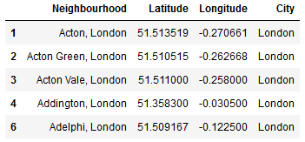
Methodology – Neighborhood Data
A table containing all the Neighborhoods was created by scrapping the coordinates source and merging.
The list was narrowed down by focusing on central areas for each cities since Foursquare data is really lacking for suburbs.

Slide 9
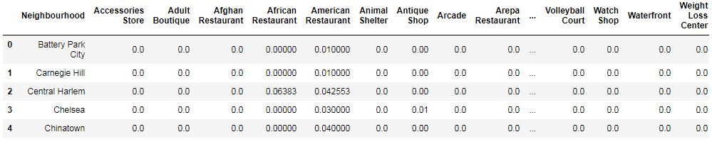
Methodology – Foursquare Scrapping
For each neighborhood center we got all the venues in a 500 yard radius from it center.
We calculated the ratio of each venue type in it’s neighborhood:
Finally, we merged the 3 data frames into a single data frame containing neighborhoods from the 3 cities.

Slide 10
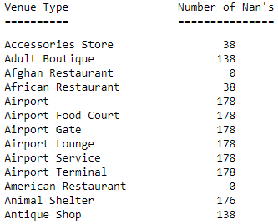
Methodology – Dealing with NaN’s
After the merge, we encountered quite a few NaN features in our data frame.
The reason for this was some venue types that are common in some cities, but non existent in other.
American Restaurant, for example, exist in all 3 cities, but Antique Shop is not.

Slide 11
Methodology – Dealing with NaN’s
Two approaches were considered:
Dropping the columns (Venue Types) that don’t exist in the 3 cities.
Replacing the Nan’s with 0.
The second approach was chosen due to 2 factors:
Not having a certain venue type, is also a feature that should be considered.
The accuracy metrics were better using the second solution.

Slide 12
Methodology – Method
To achieve our business goal, we decided to use K-nearest neighbor classifier.
This is an unsupervised training method that groups members by their feature similarity, in our case, ratio of certain venues.

Slide 13
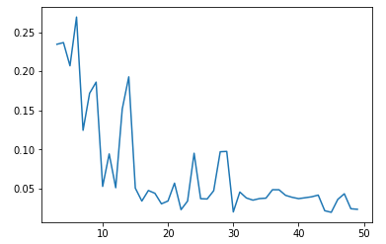
Methodology – choosing k value
Before our training we must decide on the k value – the amount of clusters we want to be created.
To do this we used the “Elbow Method”. We trained the model using different values of k and looked for the best accuracy.
We received the following graph:
The absolute best was at k=7, however
we decided it’s quite low and won’t
create good enough differentiation.

Slide 14
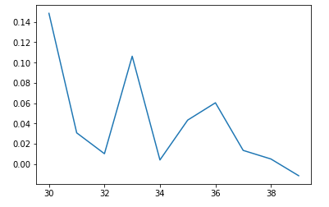
Methodology – choosing k value
A local maximum was observed in the ~32 area, so we decided to zoom the graph on that area.
After some Testing 29 was chosen as
since it yielded the best clusters.

Slide 15
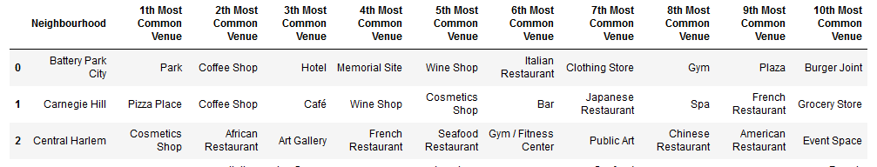
Methodology - Validation
To validate our results, we used common sense by checking the 10 most common venues in each neighborhood and see if they make sense in “sister neighborhoods” concept we planned:.

Slide 16
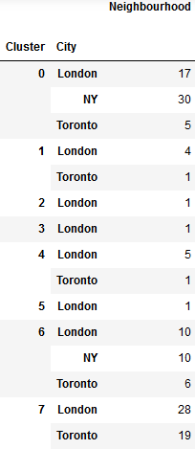
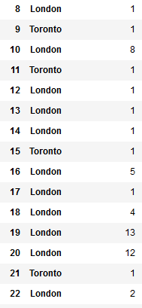
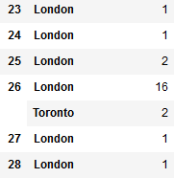
Results - Clusters
After the training, we checked to see neighborhood distribution in each cluster.
Unfourtentley we have created only 6 useful clusters – (0,1,4,6,7,26).
The other clusters contained neighborhoods that are not similar enough to be clustered.
Let’s check and characterize each of “interesting” cluster.

Slide 17
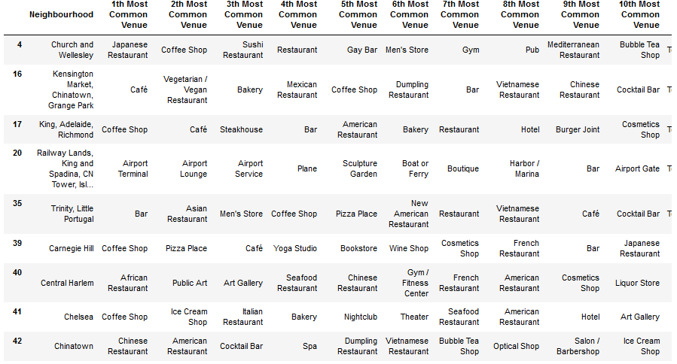
Results – Cluster 0 – Asian Style

Slide 18
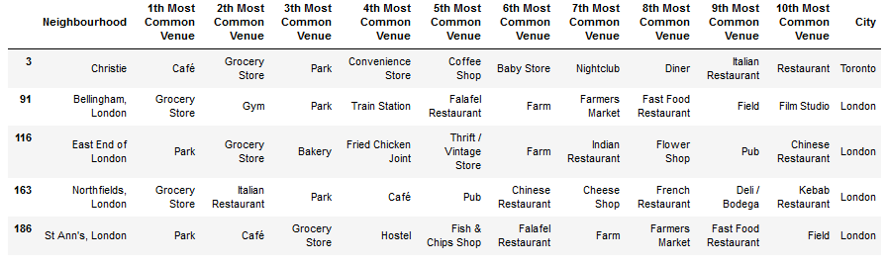
Results – Cluster 1 – Quite Living

Slide 19
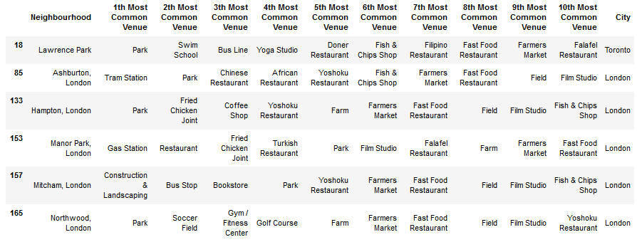
Results – Cluster 4 – Country Side

Slide 20
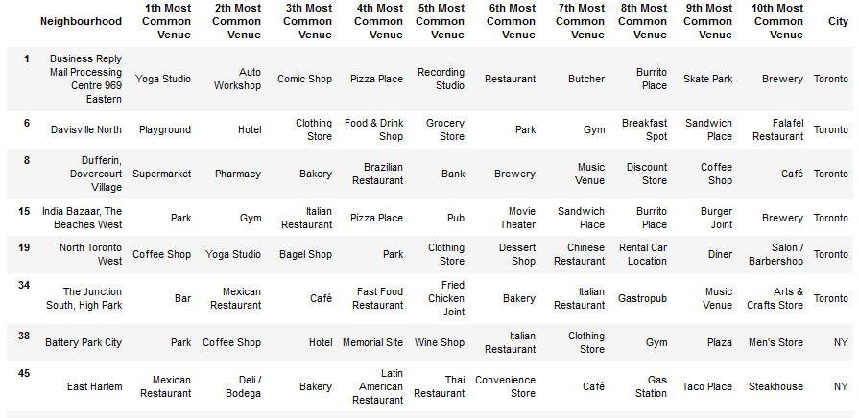
Results – Cluster 6 – Upscale Housing

Slide 21
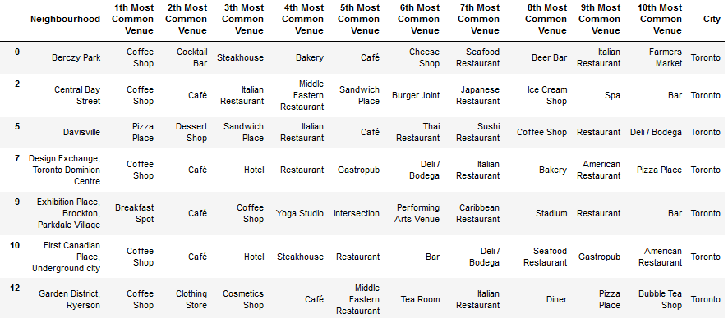
Results – Cluster 7 – Hip places

Slide 22
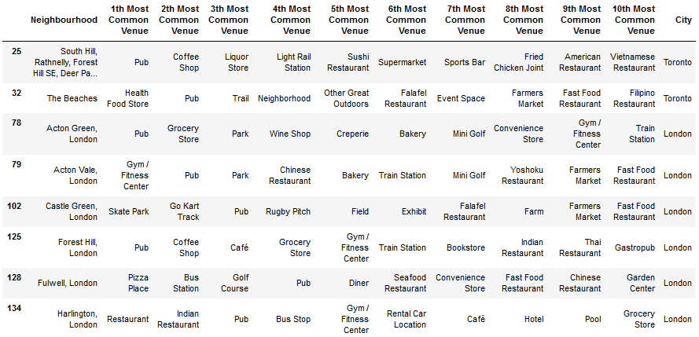
Results – Cluster 26 – Business Areas

Slide 23
Conclusions
We had a really partial success.
The clustering didn’t manage to classify all the neighborhoods and a lot of them were stuck in a single cluster.
The Clusters that did contain several neighborhoods were relatively cohesive and can be used to partly answer the initial question.
More features are needed to create a better clustering.

